Slide 1
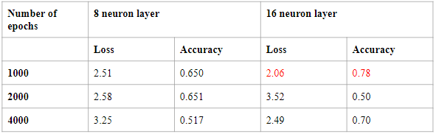
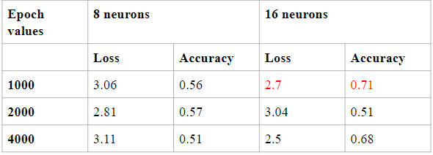
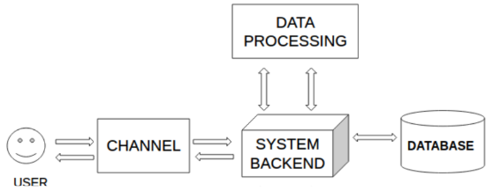




VIRTUAL ASSISTANT FOR COLLEGE
Athira S Pillai and Disha Dinesh Majithia athirapillai430@gmail.com,disha.dinesh16@gmail.com
Abstract
A chatbot system is defined as a “software program that simulate conversation with human users, using text, voice or images or a combination of spoken and visual heuristics”. Several terms are used to describe chatbots such as machine conversation systems, conversational agents, virtual agents and dialogue systems.Common for all is that they utilize a computer program that can perform tasks automatically or with minimal human intervention.
Whenever faced with unchartered territories humans have a tendency to get anxious and it is but natural- and even more so in the case of students who are about to join a new course. They are always filled with endless queries and mostly all of them are similar across people. Rather than flooding a single person with all those and to answer them over and over again, it is apt to segregate usual common queries and their solutions at a single place which is easily accessible by all. Presently, the college has no provision for any such system and therefore our suggestion to create one to simplify the redundant nature of work and utilize manpower efficiently. The need for a virtual assistant is imminent in this scenario.
Problem Statement
To create a virtual assistant to guide students who wish to take admission in the college.
Observations
To keep track of performance measures while training model, the custom metrices of the model were captured . After rigorous training procedures the best suited metrices were chosen for the model and it was seen that the final model had a loss of 2.06 and an accuracy of 0.78. For different batch number of inputs considered and error threshod value, the same procedure was carried out..
Results
There are two competing concerns: with less training data, the parameter estimates have greater variance. With less testing data, the performance statistic will have greater variance.
The data should be divided such that neither variance is too high, which is more to do with the absolute number of instances in each category rather than the percentage. Amongst the total instances, a 80-20 split validation was carried out and it was seen that for every test set of queries provided each time as input, there were correct intents chosen and responses provided 70% of the times. While the deep learning neural network was trained, it was seen that with each training epoch there was a loss of 2.06 which stated the diﬀerence between the obtained value and the true value and an accuracy of 0.78
Overfitting of model occurs when number of neurons in hidden layers were increased to 16 and the epoch value was increased to 4000. Underfitting of model occured when the number of neurons in hidden layers were made 16 and the epoch value was equal to 2000.
Sample result : User: hello
Chatbot: Good to see you, what doubt do you have regarding SCTCE
User: bye
Chatbot: Thanks for visiting
Conclusions
The main objectives of the project is to develop a chatbot that will be used to identify answers for user submitted questions. To develop a database where all the related data will be stored and to develop a web interface. The web interface developed will be for simple users. A background research including an overview of the conversation procedure and any relevant chatbots available was done. A database was developed, which stores information about questions, answers, keywords and feedback messages. A usable system shall be designed, developed and deployed to the web server. An evaluation of data collected by potential students of the college was carried out. Also after receiving feedback from the first deployment, extra requirements shall be introduced and implemented. Chatbots are used less in the academic arena thus it needs to be incorporated more into websites of colleges so that information can be passed on to the users without them having to go though the entire websites. It helps the student to get information regarding college without going through the website content and thus making human work less. It reduces tedious work that usually a user would have to carry out if they need to get any information from the website of the college. As there is no manpower employed in case of chatbot usage, it makes it easy for the users to get the required results of the queries. Information regarding activities happening inside campus and other academic information provided. The details about the college have been provided in the dataset which is used to find the required information for the query that is asked by the user.
Proposed System and Architecture
The chatbot architecture describes how the various components of the chatbot can be integrated together to form the final system. It consists of a channel which is used to interact with the user. The channel could be any software that will run on a system or if the chatbot is implemented as a web application, the website will act as the channel. The channel will be connected to the system backend which is the main part of the entire system that will be used to process the queries that the user sends to the system. This query is passed on to the data processing block of the system which will implement the algorithm used in the system to get the desired results. The keyword matching algorithm used here will attempt to identify keywords in a sentence. In the case that one or more keywords are found in the user’s input text then an answer will be retrieved. The database or the dataset used here contains the required information that will be parsed by the chatbot to obtain the desired results.
Literature cited
Bhavika R. Ranoliya Nidhi Raghuwanshi, Sanjay Singh Department of Information and Communication Technology Manipal University (2017) "Chatbot for University Related FAQs" International Conference on Advances in Computing, Communications and Informatics.
C.B.Lee, H.N.Io (2017) "Chatbots and Conversational Agents: A Bibliometric Analysis" by, IEEE International Conference on Industrial Engineering and Engineering Management.
Thomas N T Amrita (2016) "An E-business Chatbot using AIML and LSA" Intl. Conference on Advances in Computing, Communications and Informatics.
Bayu Setiaji, Ferry Wahyu Wibowo (2016) "Chatbot Using A Knowledge in Database Human-to-Machine Conversation Modeling" International Conference on Intelligent Systems, Modelling and Simulation.
AM Rahman, Abdullah Al Mamun, Alma Islam (2016) "Programming challenges of Chatbot: Current and Future Prospective" IEEE International Islamic University Chittagon.
Luis Fernando D’Haro and Rafael E. Banchs (2017) "Learning to predict the adequacy of answers in chat oriented human agent dialogs" IEEE Region 10 Conference (TENCON), Malaysia.
Algorithm
Semantic similarity algorithm is used in this system. It is carried out between two sentences is carried out as below,
Each sentence is divided into a list of tokens
The divided sentence can implement bigram set
After getting the divided sentence, it is counted
Choose the pattern with the highest sentence similarity measure
Technology Stack
Acknowledgment
We would like to express my gratitude to all those who helped us to complete this project. We would like to thank the faculty members in the Department of Computer Science and Engineering, SCT College of Engineering, Thiruvananthapuram, for giving us the opportunity and facilities to undertake the study of this topic and for its successful
completion. We are deeply indebted to our Guide, Smt. Kavitha K.V., Assistant Professor, Department of Computer Science and Engineering, SCT College of Engineering, whose help, stimulating suggestions and encouragement helped us throughout the duration of the study. Her technical knowhow and valuable hints were of immense help to us for
carrying out the study.
We are also obliged to Dr. Subu Surendran, Professor and Head of Department (Department of Computer Science and Engineering), SCT College of Engineering, for the support and encouragement provided by him to make this project a success..
Notes:
Copyright Colin Purrington (http://colinpurrington.com/tips/academic/posterdesign).

